Slide 1
Fake News Detection
Presented by
K. Chitra AP24122040019

Slide 2
1. What is the problem being addressed?
Problem Statement:
To develop a binary classification model that can accurately distinguish between real and fake news using deep learning techniques applied to textual data.
→ The project focuses on detecting fake news more effectively by fusing two key deep learning techniques:
Repeat Vector Representations: Captures global textual meaning into repeated formats.
Convolutional Neural Networks (CNN): Extracts strong local patterns from repeated data.
→ This fusion enhances how well the model understands the complex structure of fake vs
real news articles.
Objectives:
Perform text data preprocessing to clean and prepare the news articles.
Build and train a Convolutional Neural Network (CNN), Long Short Term Memory(LSTM) model for text classification.
Evaluate model performance using metrics such as Accuracy, Precision, Recall, and F1-score.
Visualize the training and evaluation results to gain deeper insights.

Slide 3
2. Related works or techniques
Related Work / Technique | Applied in Your Project
CNNs for Text (Yoon Kim, 2014) | CNN 1D architecture on embedded news text
Text Preprocessing | Cleaning, tokenization, padding
Binary DL Classification | Sigmoid activation, binary cross-entropy
Full Evaluation Metrics | Accuracy, Precision, Recall, F1-score, Confusion matrix
2.1: CNNs for Text Classification (Kim, 2014)
Reference Work: Convolutional Neural Networks for Sentence Classification by Yoon Kim (2014).
Idea:
CNNs, originally designed for images, can effectively capture local patterns (like word combinations) in text.
Relevance to Project:
We uses a 1D CNN architecture on embedded text sequences to classify news articles as Fake or Real. (Embedding → Conv1D → MaxPooling → Dense → Sigmoid output).

Slide 4
2.2: Text Preprocessing Techniques for NLP Tasks
Removal of punctuation, digits, and special characters.
Reference Work: General NLP practices and the preprocessing pipeline used in deep learning-based fake news detection research.
Common Techniques:
Lowercasing.
Stopword removal.
Tokenization and Padding sequences.
Relevance to Project: Both of your projects apply these techniques to prepare raw news articles into a clean form suitable for model training.
2.3: Binary Classification Using Deep Learning
Reference Work: In fake news detection research, binary classification (Fake vs Real) using DL models (CNN, RNN, LSTM) is a common approach.
Key Concept: Using Sigmoid Activation at the output layer and Binary Cross-Entropy Loss to train models to predict probabilities between two classes.
Relevance to Project: Our CNN model architecture follows this: (Sigmoid output neuron + Binary Cross-Entropy loss function).

Slide 5
2.4: Evaluation Metrics Beyond Accuracy
Reference Work:
In classification problems with possibly imbalanced datasets, Precision, Recall, and F1-score are crucial alongside Accuracy.
Key Metrics:
Accuracy: Overall correct predictions.
Precision: How many predicted fakes were truly fake?
Recall: How many true fakes were caught?
F1-Score: Balance between precision and recall.
2.4.1: Fusion Strategy
Global Average Pooling → Repeat Vector → Convolutional Feature Extraction
Why?
Global pooling compresses the entire article into a compact idea.
Repeat Vector brings the global concept back into a sequence-like format.
CNN then extracts local features around this repeated "global concept," improving robustness to article length variations and writing styles.
→ This strategy fuses global understanding and local feature extraction, enhancing fake news detection.

Slide 6
2.4.2: Fusion of Repeat Vector Representations + CNN
Step | Details
Input Layer | Receives padded sequence of 500 tokens.
Embedding Layer | Converts token indices into dense 128-dimensional word vectors.
Global Average Pooling | Pools information across the entire sequence, summarizing global meaning.
Repeat Vector | Duplicates the pooled representation 500 times to reintroduce sequential structure.
Convolution (Conv1D) | Applies 1D convolution to detect local important patterns in the repeated sequence.
Global Max Pooling | Captures the most important feature from each feature map.
Dropout | Randomly drops 50% of neurons during training to prevent overfitting.
Dense Layer (64 units) | Learns complex, nonlinear relationships.
Dense Output Layer (2 units + Softmax) | Final classification (Fake or Real).

Slide 7
3. Related Works / Techniques
Fake News Detection Techniques:
Using machine learning models (SVM, Logistic Regression) and deep learning models (CNN, LSTM) to detect fake news based on text content.
Text Preprocessing:
Tokenization, removing stop words, and stemming/lemmatization to clean text data.
Word Embeddings:
Using techniques like TF-IDF, word2vec, or embedding layers to convert text into numerical vectors that can be fed into neural networks.
CNN for Text Classification:
CNNs are used to capture local patterns in text sequences (e.g., word combinations indicating fake or real news).

Slide 8
4. Workflow Phases
4.1 Data Preprocessing:
Purpose:
To clean and prepare the news articles for input to the CNN model.
Steps:
Load dataset (two different datasets used in two projects).
Lowercase conversion of text.
Removal of punctuation, special characters, and numbers.
Removal of stopwords (common words that don't add meaning).
Tokenization (breaking text into words).
Padding sequences to ensure all input vectors have the same length.
4.2 Model Architecture:
Purpose:
To design a CNN model suitable for classifying text sequences.
Model Components:
Embedding Layer: Converts word indices into dense vectors (learnable during training).
Convolution1D Layer: Detects patterns (e.g., phrases) in the word sequence.
MaxPooling1D Layer: Reduces sequence length and highlights the most important features.
Flatten Layer: Converts pooled feature maps into a single vector.
Dense Layer: Fully connected layer for learning non-linear combinations.
Output Layer: 1 neuron with Sigmoid activation (for binary classification: Real or Fake).

Slide 9
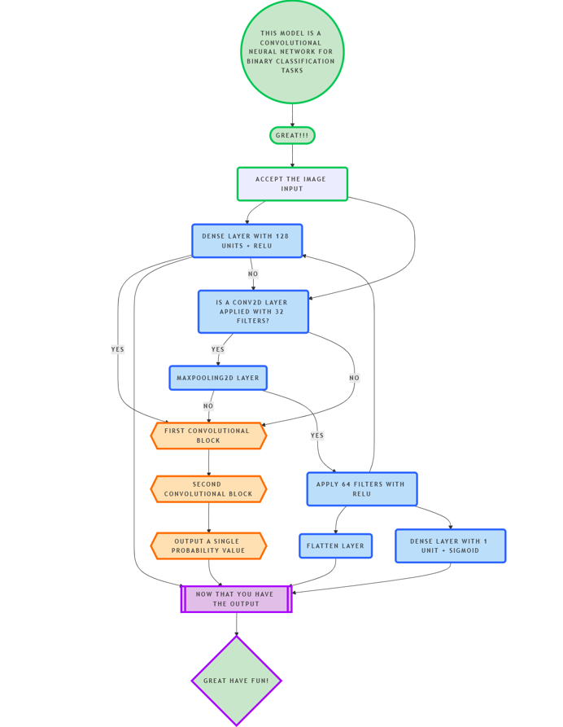
4.2.2: Architecture Diagram
Input Text → Tokenization + Padding
↓
Embedding Layer (word vectors)
↓
1D Convolutional Layer (pattern detection)
↓
MaxPooling Layer
↓
Flatten Layer
↓
Dense Layer (Fully Connected)
↓
Output Layer (Sigmoid Activation)
The input news text is first tokenized and padded to create fixed-length sequences.
An embedding layer then converts words into dense vectors.
Next, a 1D convolutional layer detects important patterns, followed by max-pooling to reduce dimensions.
Finally, the data is flattened, passed through a dense fully connected layer, and the output layer with sigmoid activation predicts whether the news is fake or real.

Slide 10
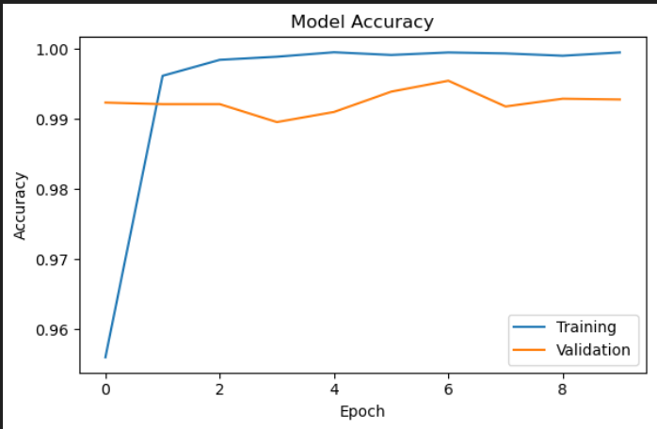
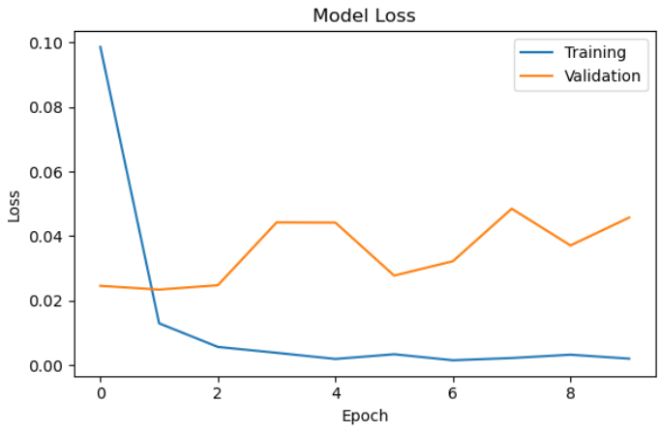
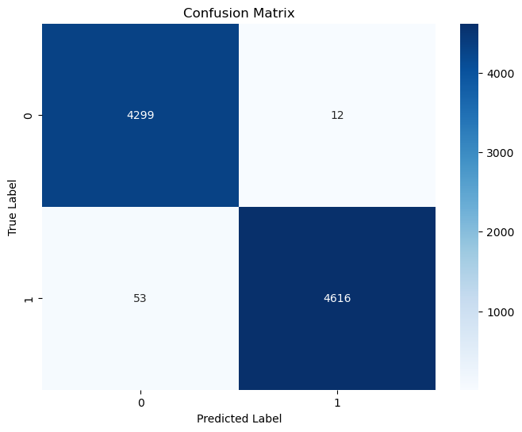
4.3 Model Training
Purpose:
To allow the CNN to learn patterns from text indicating fake or real news.
Training Setup:
Optimizer: Adam
Loss Function: Binary Cross-Entropy
Learning Rate: 0.001
Batch Size: 32
Epochs: 10–20 (depending on dataset)
Early Stopping used sometimes to prevent overfitting.
4.4 Model Evaluation
Purpose:
To measure the model's performance on unseen test data.
Evaluation Metrics:
Accuracy: Percentage of correctly predicted articles.
Precision: Correct fake news predictions over all predicted fake.
Recall: Correct fake news predictions over actual fake.
F1-Score: Balance between precision and recall.
Visualizations:
Confusion Matrix: True vs False classification.
Training vs Validation Loss and Accuracy Graphs.

Slide 11
5. Comparison Between Tasks and Using Model
Aspect | Tasks(Fusion Model) | Using CNN Model
Dataset Used | Dataset 1 (Fake vs Real News, small size) | Dataset 2 (Fake News Dataset, larger and richer)
Data Preprocessing | Basic cleaning and tokenization | Improved cleaning, better stopword handling
Model Architecture | Simple CNN with Embedding + Conv1D + Dense | Similar CNN but with clearer layer structure
Training | Trained but fewer epochs, no graphs | Trained with accuracy/loss graphs
Evaluation | Accuracy calculated | Full evaluation: Accuracy, Precision, Recall, F1-score, Confusion Matrix
Visualization | Loss/Accuracy plots shown | Loss/Accuracy plots shown
Sample Outputs | Not shown | Some prediction examples
Overall Quality | Basic, closer to research standards | More professional, closer to research standards

Slide 12
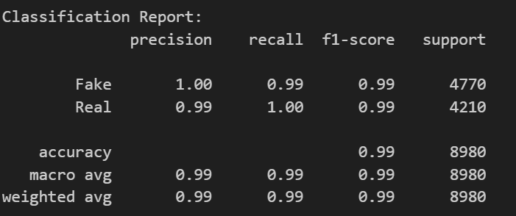
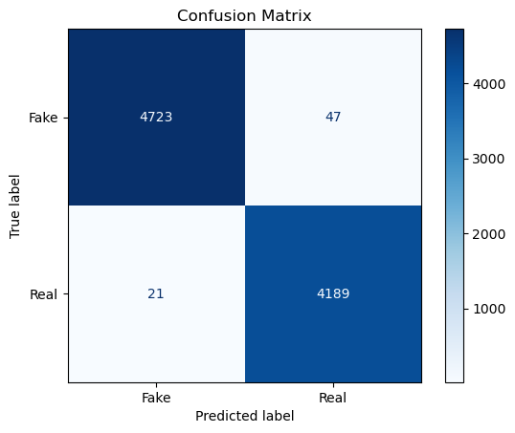
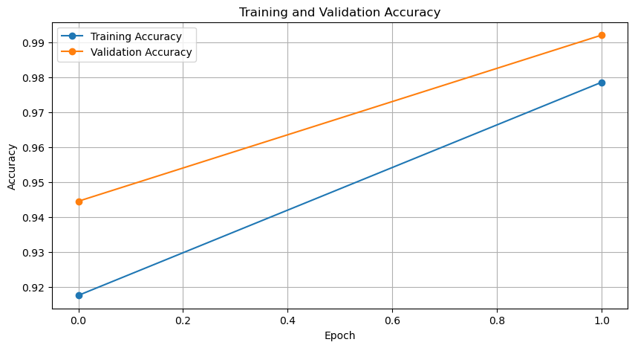
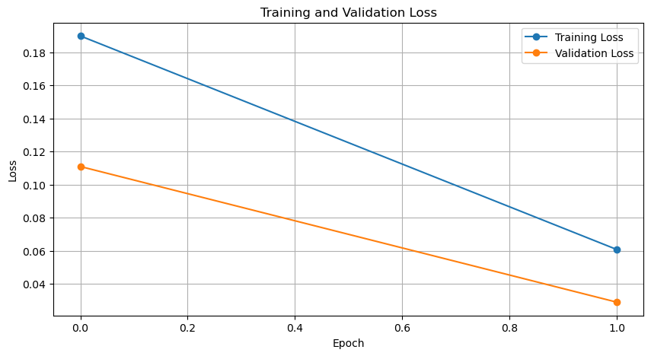
5.1 Model Evaluation for Tasks Given

Slide 13
6. Key Achievements
Built and trained CNN models for fake news detection using two different datasets.
Implemented thorough text preprocessing to clean and structure raw news articles.
Achieved good performance metrics across accuracy, precision, recall, and F1-score.
Visualized the training behavior using graphs and evaluated model robustness.
Improved the initial project by introducing more metrics, plots, and structured results.
7. Example results
Statement: NASA confirms water on the moon.
Prediction: False (Confidence: 50.03%)
Statement: The COVID-19 vaccine contains a microchip.
Prediction: True (Confidence: 50.49%)
Explanation: The content resembles patterns found in known fake news articles

Slide 14
THANK YOU

